Slide 1

CN101.3 - Data Communication and Network
Department of Network and Security
Error Detection and Correction
Isuru Sri Bandara
isuru.s@nsbm.ac.lk

Slide 2
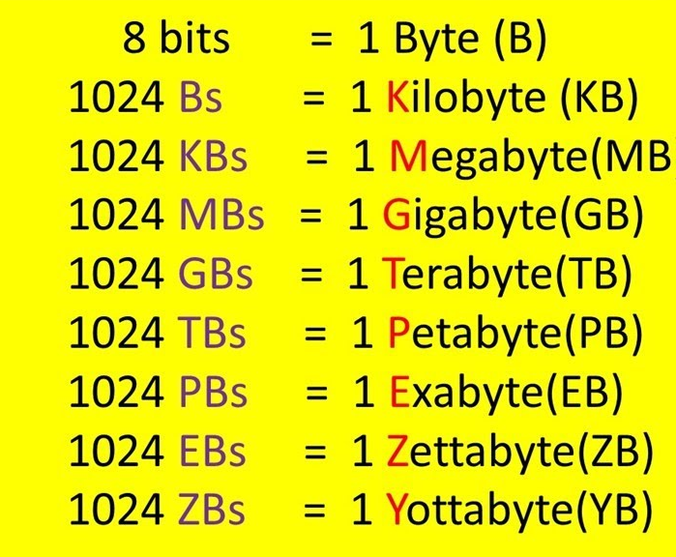
Data Storage Measurements

Slide 3
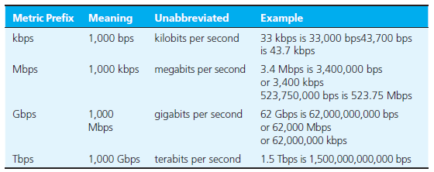
Speed of Data transmission

Slide 4
KB, kB and KiB Deference
"1 KB" means 1024 bytes (as Windows would report it, traditional usage)
"1 kB" means 1000 bytes (as Mac OS would report it, IEC usage)
"1 KiB" means 1024 bytes (unambiguous, but perhaps unfamiliar terminology)

Slide 5

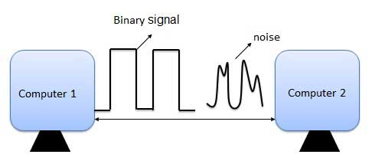
What is an Error ?
Error is a condition when the output information does not match with the input information
During Transmission, Digital signals suffer from noise that can introduce errors in the binary bits travelling from one system to other
That means a 0 bit may changes to 1 or a 1 bit may change to 0

Slide 6

What is noise in communication ?
Noise essentially is anything that distorts a message by interfering with the communication process.
E.g: - * radio playing in the background
* any other distractions that prevent the receiver from paying attention

Slide 7
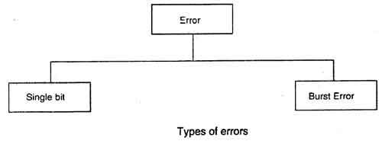
Types of Errors ?

Slide 8
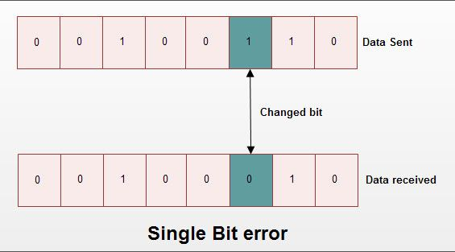
Single Bit Error
It means only one bit of data unit is changed from 1 to 0 or from 0 to 1 as shown in following figure.
Single bit errors can happen in parallel transmission,
where all the data bits are transmitted using separate wires.

Slide 9
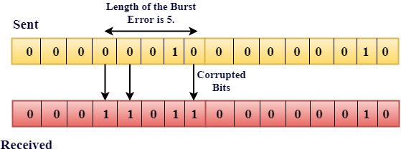
Burst Error
It means two or more bits in data unit are changed from 1 to 0 or from 0 to 1 as shown in following figure
In Burst error, it is not necessary that only consecutive bits are changed.
The length of burst error is measured from first changed bit to last changed bit.
As shown in fig. length of burst error is 8, although some bits are unchanged in between.

Slide 10
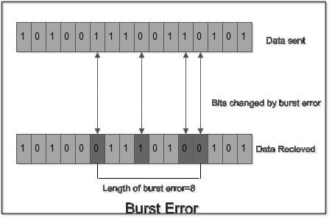
What do you think about this ?

Slide 11
Error Detecting Codes ?
Whenever a message is transmitted, it may get scrambled by noise or data may get corrupted.
To avoid this, we use error-detecting codes which are additional data added to a given digital message to help us detect if an error occurred during transmission of the message.
A simple example of error-detecting code is parity check.

Slide 12
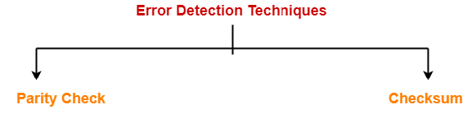
Types of error detecting techniques

Slide 13
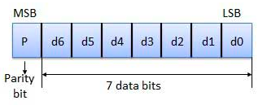
Parity Checking of Error Detection
It is the simplest technique for detecting and correcting errors.
The Most Significant Bit (MSB) of an 8-bits word is used as the parity bit and the remaining 7 bits are used as data or message bits.
The parity of 8-bits transmitted word can be either even parity or odd parity.
Even parity -- Even parity means the number of 1's in the given word including
the parity bit should be even (2,4,6,....).
Odd parity -- Odd parity means the number of 1's in the given word including
the parity bit should be odd (1,3,5,....).

Slide 14


Use of Parity Bit ?
The parity bit can be set to 0 and 1 depending on the type of the parity required.
For even parity, this bit is set to 1 or 0 such that the no. of "1 bits" in the entire word is even. Shown in fig. (a).
For odd parity, this bit is set to 1 or 0 such that the no. of "1 bits" in the entire word is odd. Shown in fig. (b).
Fig. (a)
Fig. (b)

Slide 15
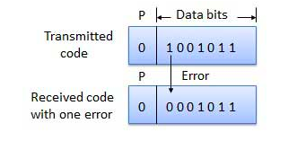
How Does Error Detection Take Place ?
Parity checking at the receiver can detect the presence of an error if the parity of the receiver signal is different from the expected parity.
That means, if it is known that the parity of the transmitted signal is always going to be "even" and if the received signal has an odd parity, then the receiver can conclude that the received signal is not correct.
If an error is detected, then the receiver will ignore the received byte and request for retransmission of the same byte to the transmitter.

Slide 16
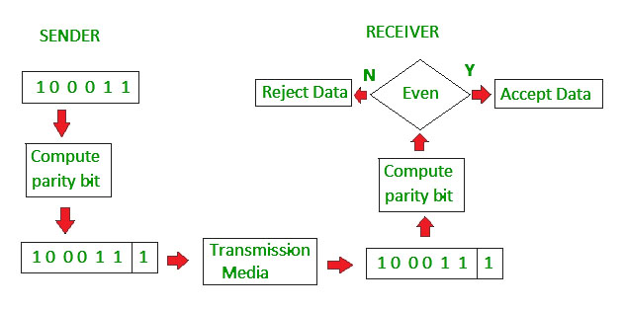
How Does Error Detection Take Place ?

Slide 17
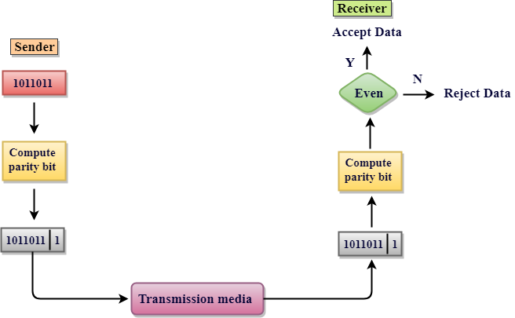
How Does Error Detection Take Place ?

Slide 18
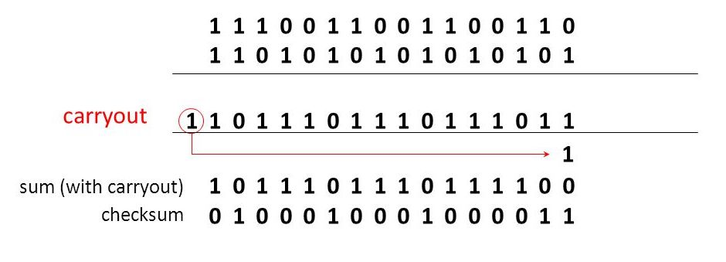
The Internet Checksum ?
Error detecting code used in many internet standard protocols, including IP, TCP and UDP
Ones Complement addition
The two numbers are treated as unsigned binary integers and added
If there is a carry out from the leftmost bit, add 1 to the sum
(end- around carry)
Ones Complement Operation
Replace 0 digits with 1 digits and 1 digits with 0 digits

Slide 19
Task
Find internet checksum for following binary packet sequence
1. 10010101 10111101
2. 11110110 11100110
3. 11110111 10111101
4. 11011101 10000101
5. 10011111 10110100
Notes:
1. 10010101 10111101 = 11001100
2. 11110110 11100110 = 00100010
3. 11110111 10111101 = 01001010
4. 11011101 10000101 = 10011100
5. 10011111 10110100 = 10101011

Slide 20

Multiplexing

Slide 21
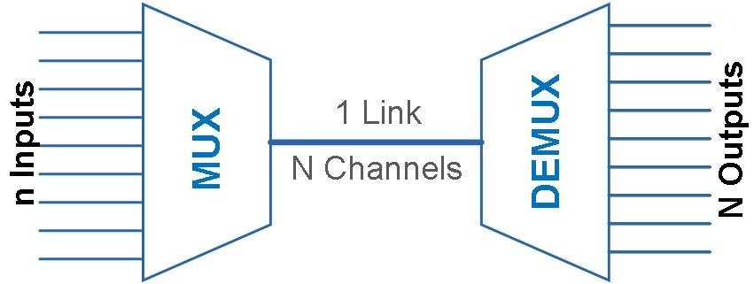
What is Multiplexing ?
Multiplexing (or muxing) is a way of sending multiple signals or streams of information over a communication link at the same time in the form of a single, Complex signal.
The receiver recovers the separate signals, a process called demultiplexing (or demuxing ).

Slide 22
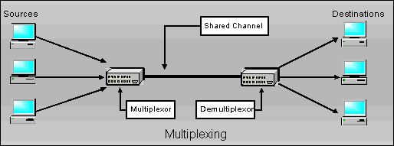
Simple Example for Multiplexing
Phone calls are a good example of multiplexing in telecommunication. That is, more than one phone call is transmitted over a single medium.

Slide 23
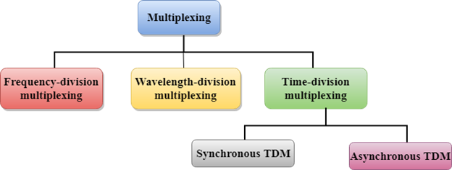
Multiplexing Techniques

Slide 24
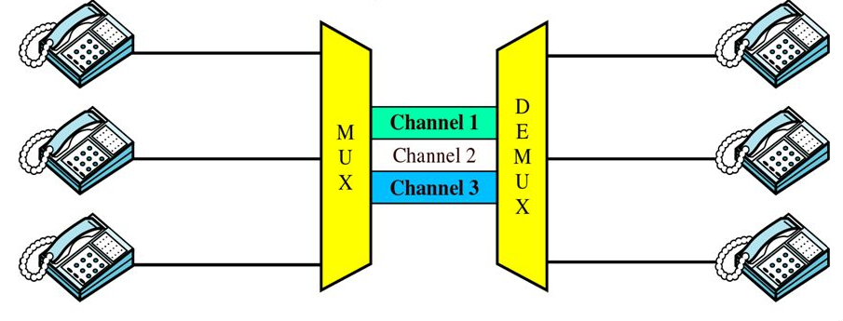
Frequency Division Multiplexing (FDM)
In FDM, all users use the same common channel at the same time (for full time).
But they are allotted different frequencies to prevent any kind of signal interference.
So, the Bandwidth is divided among users not time.
Note - There is possibility of crosstalk in FDM since all the signals are transmitted simultaneously.

Slide 25
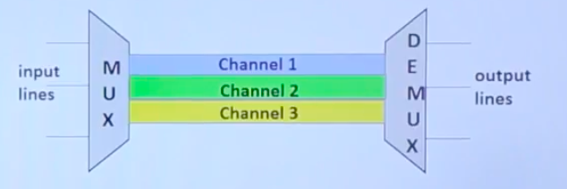
Frequency Division Multiplexing (FDM) Application
FDM is an analog technique that can be applied when the bandwidth is of a link (in hertz) is greater than the combined Bandwidths of the signals to be transmitted.
FDM is an analog multiplexing technique that combines analog signals.

Slide 26
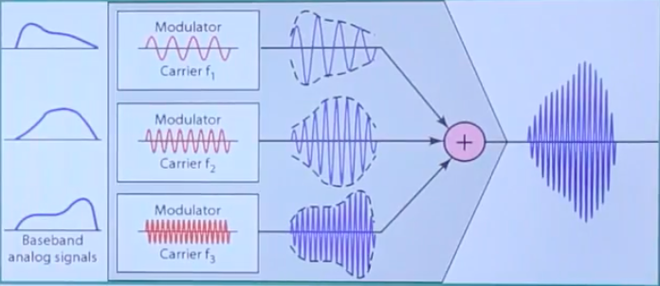
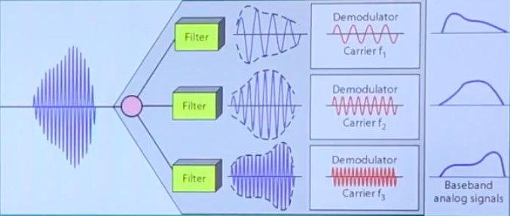
Frequency Division Multiplexing

Slide 27
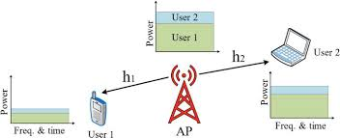
Time Division Multiplexing (TDM)
In TDM, the complete channel Bandwidth is allotted to one user for a fixed time slot.
It means each user can use the full available Bandwidth but for a fixed time (its own time slot).
Note - There is NO possibility of crosstalk in TDM since all users are using the full Bandwidth separately.

Slide 28
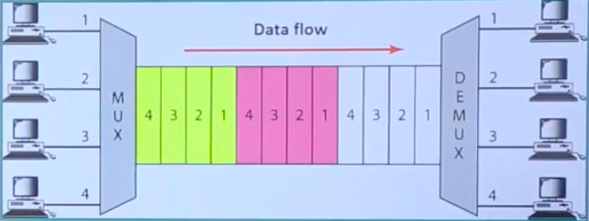
Time Division Multiplexing (TDM) Application
TDM is digital multiplexing technique for combining several low rate channels into one high rate channel.

Slide 29
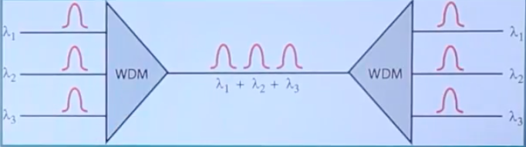
Wavelength Division Multiplexing (WDM)
Wavelength Division Multiplexing (WDM) is an optical (fiber-optic) transmission technique that enables the use of multiple light wavelengths (or colors) to send data over the same medium.
To utilize the high data rate capability of fiber-optic cable, WDM has been devised.
WDM is an analog multiplexing technique to combine optical signals.

